Slide 1
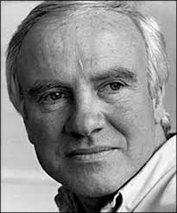
Patrick Caulfield
Botr

Slide 2
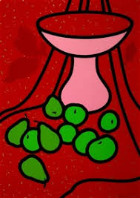
Patrick Caulfield

